Slide 1

Team Name : Garuda_Code
Vetri Selvi B | 2026 | CMR University
Vandana D L | 2026 | CMR University
Telugu Rajesh Kumar | 2026 | CMR University
Amith Raj | 2026 | CMR University
Garuda_Code

Slide 2
Past Experience
GramFinance + DeFi
A decentralized finance platform enabling micro-loans, savings, and insurance for rural communities via local agents using Ethereum smart contracts. Integrated WhatsApp-based AI assistant for multilingual and voice-enabled financial services.
Agentic Ethereum Hackathon – India
Built an autonomous DeFi agent capable of onboarding rural users, managing micro-loans, and generating financial insights using LlamaIndex + GPT-powered chatbots. Collaborated with a cross-functional team to design blockchain-based solutions for financial inclusion, earning positive feedback from industry mentors.
Garuda_Code

Slide 3
Document Summarization
Ingest & Preprocess Documents – Accept policy files (.pdf, .csv, .docx), extract text (PyPDF) and tabular data (Camelot) for analysis.
LLM-based Summarization – Generate separate summaries for text and tables using tailored GPT prompts.
Merge & Finalize – Combine both summaries into a concise, actionable final policy summary.
Garuda_Code

Slide 4
Tech Stack
Cloud Service Providers - AWS (S3 for document storage, EC2 for hosting), or Azure alternative.
Database - PostgreSQL for metadata storage, MongoDB for unstructured summaries.
Backend - Python (FastAPI), LlamaIndex for document processing, OpenAI GPT API.
Frontend - Streamlit (for quick demo UI) or React.js for production dashboard.
Garuda_Code

Slide 5
Architecture
Document Ingestion – Accepts policy files in PDF, DOCX, and CSV formats.
Preprocessing – Extracts text using PyPDF2/docx2txt and parses tables using Camelot/Pandas.
Parallel Processing Pipelines – Separately process text and tabular data for clarity and precision.
LLM-Powered Summarization – GPT-based models summarize policy paragraphs and interpret tabular compliance data.
Aggregation – Merge text and table summaries into a single, concise final summary.
Output Formats – Provide summaries in executive overview, bullet points, and structured JSON for integrations.
Scalability – Can be deployed on cloud platforms for large-scale policy analysis.
Garuda_Code

Slide 6
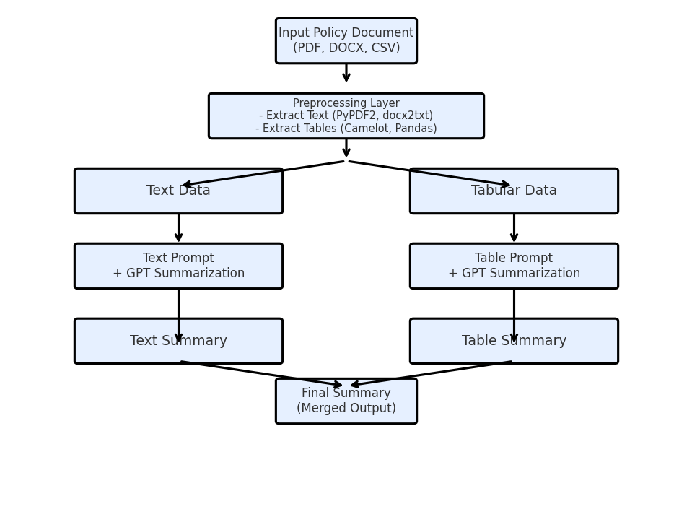
Data Flow Diagram
Garuda_Code

Slide 7
USP of our approach
Dual-Pipeline – Processes text and tables together for complete detail capture.
Custom LLM Prompts – Extracts actions, responsibilities, and rules accurately.
Integrated Summarization – Combines outputs into one clear, actionable summary.
Scalable & Flexible – Supports multiple formats; deployable on-prem or cloud.
Structured Output – Provides summaries as overview, bullet points, and JSON.
Domain Adaptable – Easily fine-tuned for legal, HR, finance, or compliance needs.
Garuda_Code

Slide 8
Future possible enhancements
Multilingual Support – Summarize policies in any language.
Auto Policy Updates – Track and refresh summaries for new versions.
Smart Search – Find exact clauses via natural language queries.
System Integration – Connect with HR, ERP, and compliance tools.
Visual Insights – Turn data into charts and interactive views.
Self-Learning Models – Improve accuracy with continuous feedback.
Garuda_Code

Slide 9
Risks/Challenges/Dependencies
Data Sensitivity at Scale – Securely managing large volumes of confidential policy data.
Contextual Accuracy – Ensuring AI understands nuanced legal and compliance terms.
Document Diversity – Adapting to varied formats, layouts, and quality of inputs.
Performance Under Load – Maintaining speed and reliability for high-volume processing.
Ecosystem Reliance – Smooth operation dependent on third-party APIs and integrations.
Evolving Regulations – Keeping pace with changing compliance laws and standards.
Garuda_Code

Slide 10
Acceptance Criteria Coverage
Our solution comprehensively addresses the problem statement by handling both text and tabular data, accurately extracting policy actions, responsibilities, and compliance rules, and merging them into a single actionable summary. It supports multiple file formats, offers scalable deployment on-premises or in the cloud, and provides structured outputs in various formats for seamless integration into enterprise systems. Additionally, its domain adaptability allows easy customization for legal, HR, finance, and compliance needs, while maintaining high accuracy, security, and efficiency in processing large volumes of documents.
Garuda_Code

Slide 11
Thank You
Garuda_Code

